Slide 1
Automated Sickle Cell Anemia Detector (A.S.C.A.D)
Linus Castelino – 05
Gemmy George – 22

Slide 2
‘Detection of Abnormal Findings in Human RBC in Diagnosing Sickle Cell Anemia using Image Processing’, Pranati Rakshit, Kriti Bhownik, CMITA-2013.

Slide 3
Sickle Cell Anemia
Sickle cell anemia (drepanocytosis) is a disorder of the blood caused by an inherited abnormal hemoglobin.
The abnormal hemoglobin causes distorted sickled shaped red blood cells. The sickled red blood cells are fragile and prone to rupture causing anemia.
The irregular sickled cells also block blood vessels causing tissue and organ damage, and thus reduces life expectancy.

Slide 4
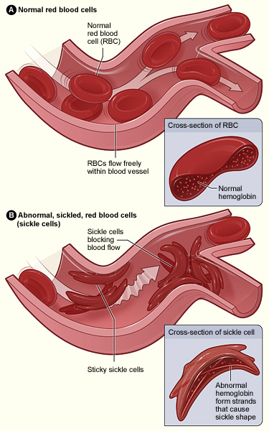
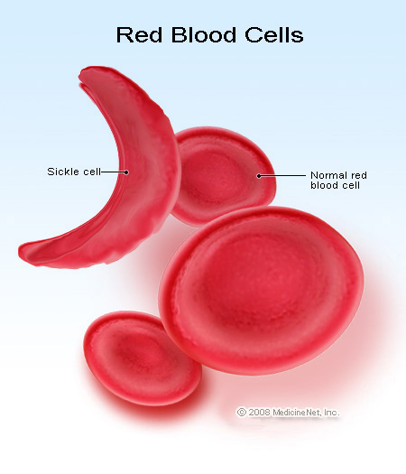

Slide 5

Traditionally…

Slide 6
Image Processing
Image processing is the processing of an input image to obtain certain set of characteristics or parameters related to the image.

Slide 7
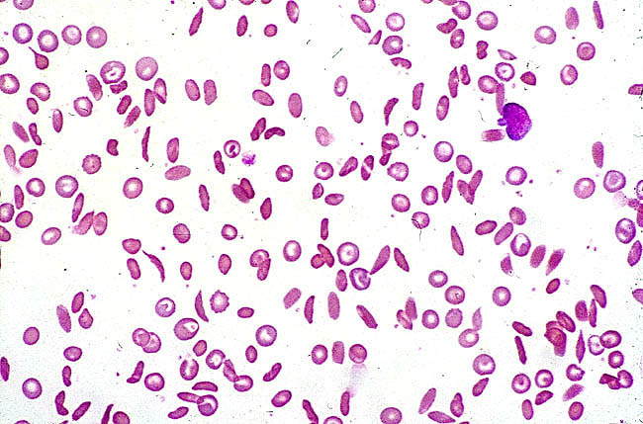
Our Implementation

Slide 8
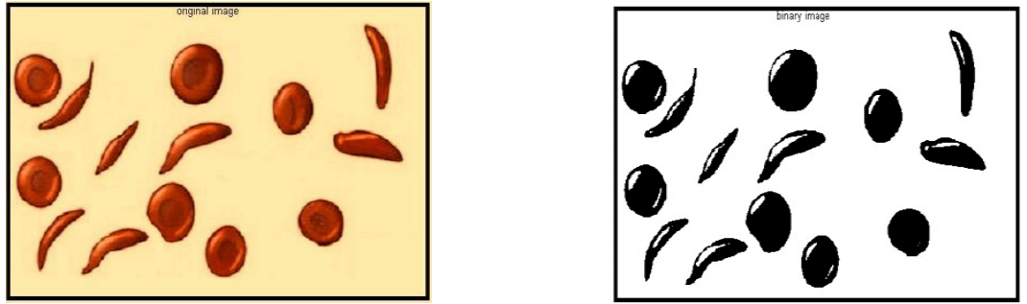
Our Implementation (Algorithm)
1. Stained and magnified human blood smear image is fed to the program as input and is converted to binary image.
2. The image is complemented and for the ease of further processing, small unwanted spots are removed from it using bwareaopen which removes all the objects in the diagram containing fewer than the number of pixels mentioned in the threshold level.

Slide 9
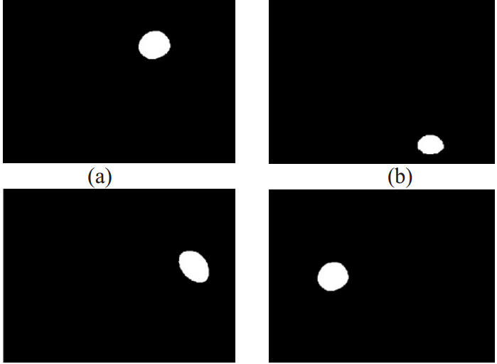
Our Implementation (Algorithm)
3. Number of similar components is detected using bwconncomp.
4. Area of each of the components is calculated using regionprops on the connected objects.
5. Detected corpuscles are displayed one by one and then corresponding surface area is displayed in the software command window.

Slide 10
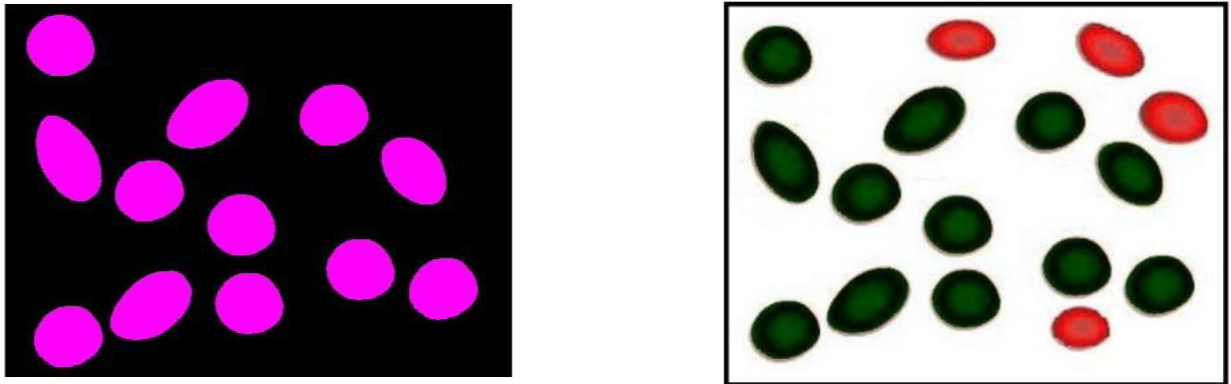
Our Implementation (Algorithm)
6. Discarding the smaller background objects, only the larger RBCs are considered and pre-processed for going through rest of the steps.

Slide 11
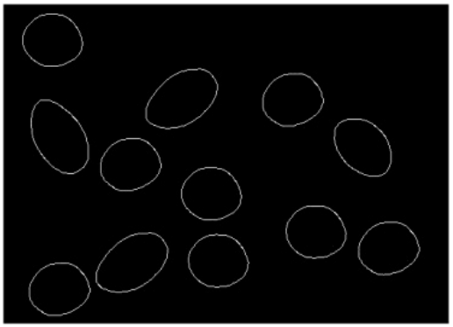
Our Implementation (Algorithm)
7. Edges of these RBCs are detected using Sobel edge detection algorithm.

Slide 12
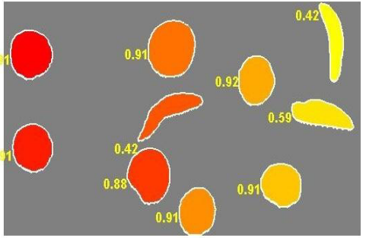
Our Implementation (Algorithm)
8. Boundary of each of the elements are traversed and marked over the objects and perimeter is calculated from the obtained boundary measurement.
9. Metric [i.e. (4*pi*area) / perimeter^2] is calculated for each object.
By this metric value, any deviation or change in shape of RBC is detected which are helpful in diagnosing some cases of anaemia like sickle cell anaemia.

Slide 13
References
‘Use of Image Processing Techniques to Automatically Diagnose Sickle Cell Anemia Present in Red Blood Cell Smear’, Siddhart Barpanda, NIIT, 2013.

Slide 14
Thank You!!!

